Slide 1

Term Paper ON
A/B Testing in digital marketing
Submitted by
Vipin Kumar Dinkar 03916404517
Under the supervision of
Dr. M. Bala Krishnan Associate Professor
in partial fulfilment of the requirement for the award of degree of
MASTER OF COMPUTER APPLICATION IN
SOFTWARE ENGINEERING
University School of Information, Communication & Technology, Guru Gobind Singh Indraprastha University, New Delhi.
Jan-May, 2020

Slide 2
Table of Contents
1. Problem Statement
2. Introduction
3. Flowchart
4. Cookie and Preferences
5. Survey
6. Conclusion
7. References

Slide 3
Problem Statement
We live in a world where we have our differences in choice things. We are given several options to choose from but sometimes we have almost get confused and can’t decide what’s best for us[9]. Imagine you visit a website and it asked what color scheme you likewise. dark or white or single page view or multiple or size and other things which you don’t know. Would you like to waste your time in answering questions if you are a rare visitor Every time? Imagine several websites you visit asked these questions?
So why shouldn’t we have a single preference which will do it for every site you visit.
Also, these websites store a lot of user’s data on their sever without their knowing until GDPR
(EU only) happened but since the www is filled with so many sites its impossible to track every site/app which doesn’t follow the bindings of IT Acts.

Slide 4
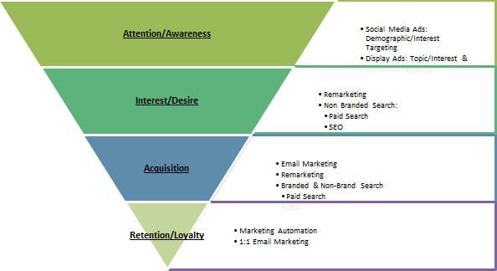
Introduction
In this digital world we have several sources of information. But we only read the ones which source looks and feels good enough. So, sites which still have old UI/UX [8] trend will lack users.
Digital marketing will only help you to get the users on your site but you will need good presentable site so that they don’t jump off easily. So, if your landing page is attractive users
will stay and will traverse more of the site else, they will leave.[10]
Digital Marketing
It is a way to attract users, improve site’s search ranking and creating awareness about the organization, site or product and services.[6]
Digital marketing follows a certain model: [11]

Slide 5
A/B Testing
In A/B testing different versions of same site/app’s landing page are prepared and the user sees one kind randomly or on based on hypothesis or on some research. This helps in reducing overhead of user feedback and then changes made to the site/app. After seeing results we can just switch to the version that gets the most conversion.
A/B Testing in Digital Marketing
The goal of digital marketing is to capture the market efficiently. But due to different mind sets and likes it’s hard to understand what users like.[10] So, A/B tests are automated in landing pages of apps/sites since they are the first thing a user sees. Multiple versions of them are made. Even the ads we see on internet uses a/b testing. Personalization improves retention.[5]
Client-side storage
There are so many ways to store data on user’s side. Like we can use cookies. Localstorage, cache etc. Using cookies will always be better as they can be sent via HTTP requests in headers but they are also flawed with security.
Since we are using cookies [7] and not storing any private information like credit card number, mobile number then its fairly safe and fast.

Slide 6
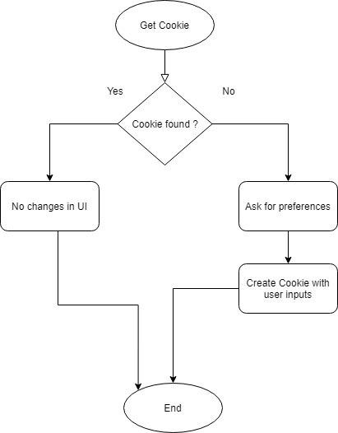
Flow Chart
This flowchart shows the sequential flow of the algorithm. From initial state to the final state.

Slide 7
Cookie and Preference
Cookie is a small piece of data stored on the client’s device/computer. They came in handy when the app wants to remember the users. From session management, tracking you and personalization they are superior to any database technology out there as they are light weight and doesn’t require much space and computing. Though now we have localstorage and sessionStorage but cookies still exist.
Cookies are saved in name-value pairs like: Uname = java script.
Several ways to create cookies every language got its own syntax and method. JavaScript cookies are the most famous ones.

Slide 8



Cookies can be time limited they will expire after a specified amount of time.
The cookie will have preferences like font size, theme option (light or dark), image quality (high, mid,low).
There can be several preferences which will allow users to feel more like home, personalised. Like they are using the app/site from long ago. It helps in retaining the customers and helps in converting them into regulars and improving the conversion rate upto 52%.[3][5]
A Good developer knows what are the good versions of the site/app but he still cant make 100% accurate predictions so we allow users to make changes to the version he was served and see if majority of the visitors does the same or not.
Preference Sample

Slide 9
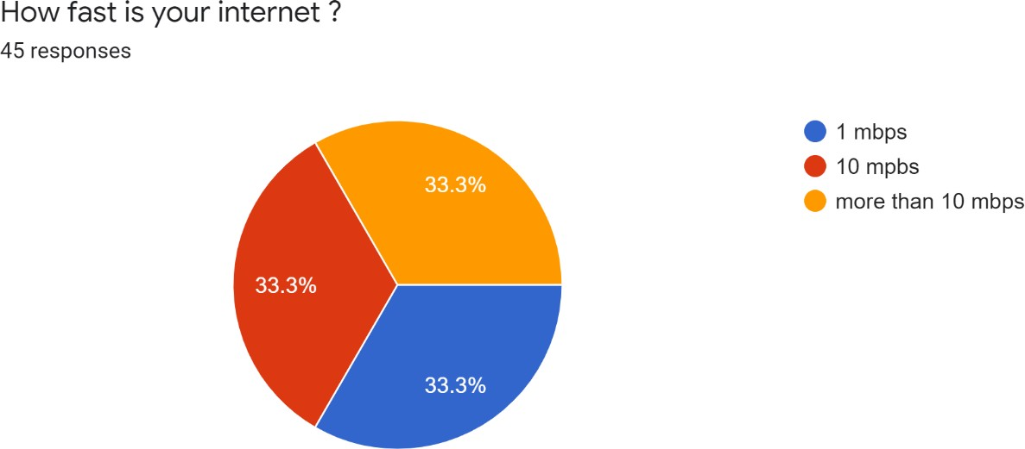
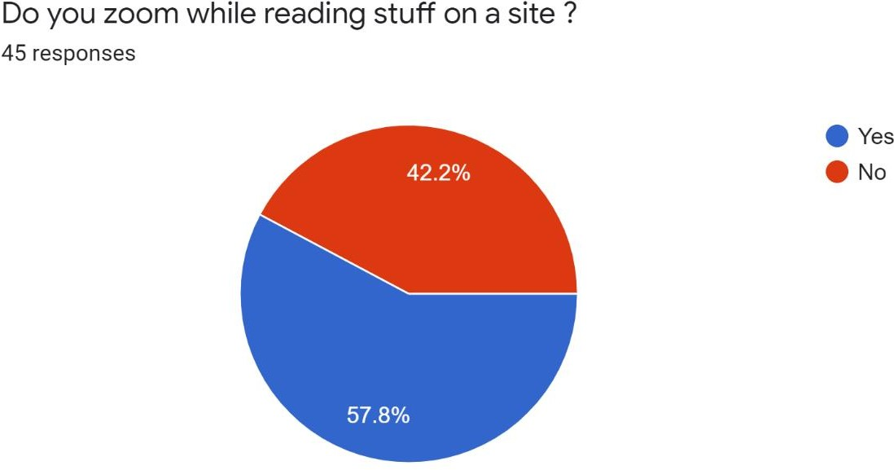
Survey
So, I created a google form to get user preferences but the google form felt boring and bland then I found the fobi bot and created the bot for the survey now it’s more pleasing and its like someone is actual giving you attention.
The URL is below: https://app.fobi.io/#/f/ZubTrJC

Slide 10
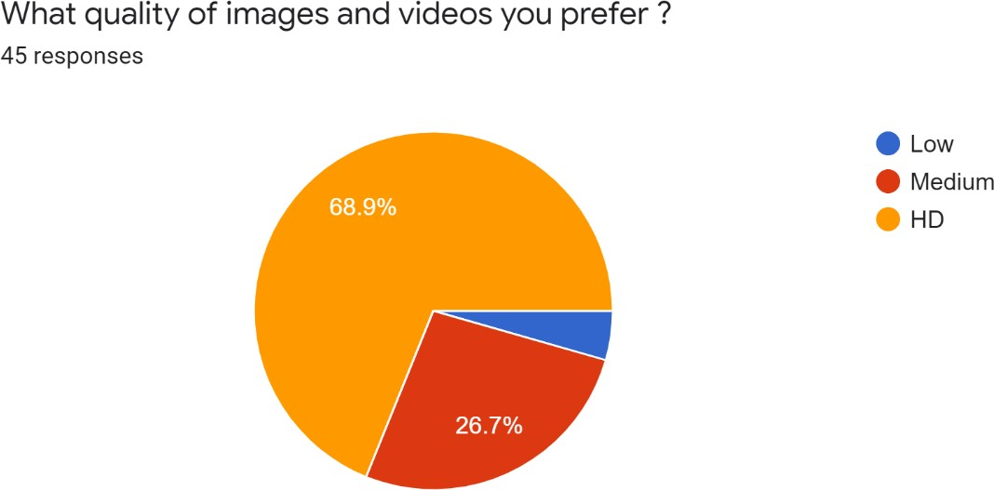
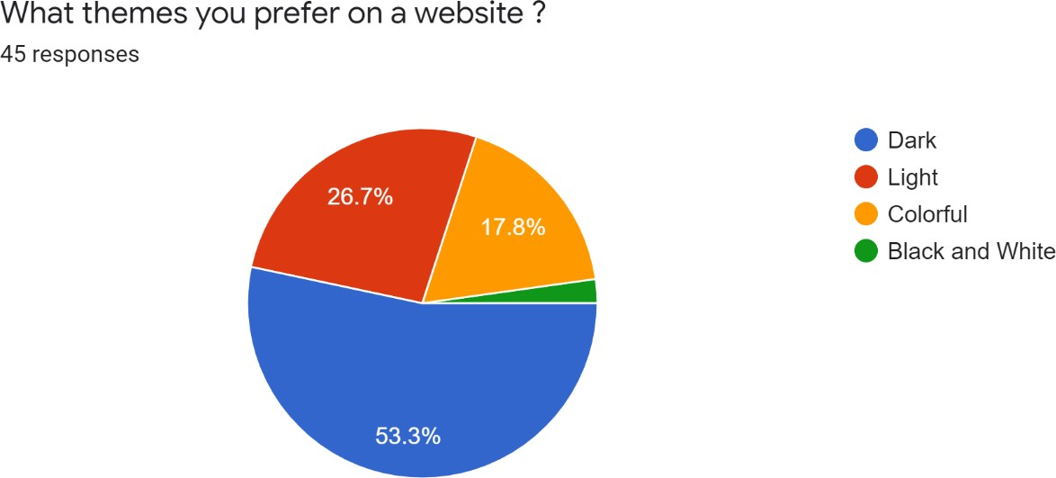
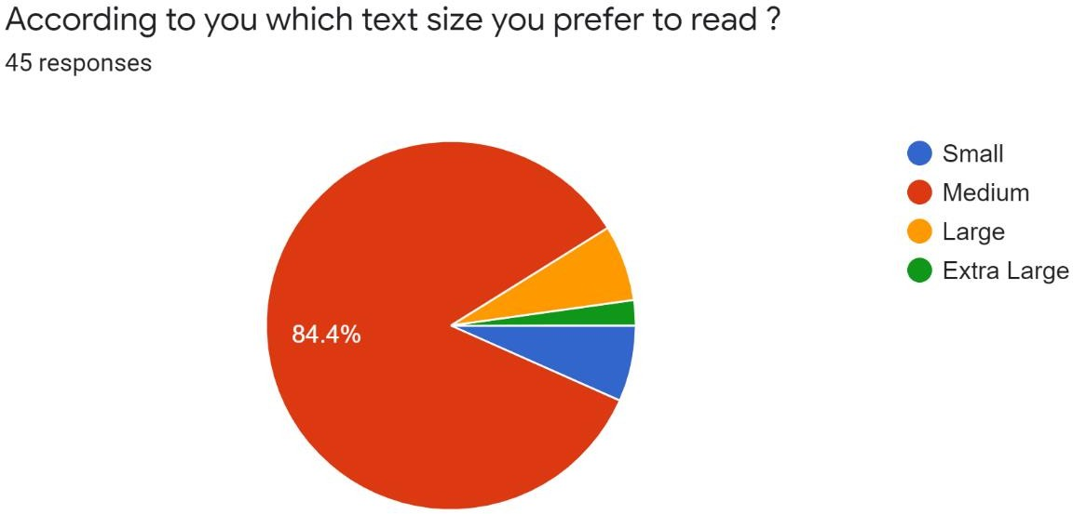

Slide 11
Conclusion
As seen in the survey, everyone has a preference according to which they stay on a site/app. If we can identify them and provide it as an option then the chance of retaining the client in- creases. [5]
We can find different versions based on the preferences we got this way we don’t have to make premutation for different versions. [1]
Another useful idea is there should be a standard preference which every site/app can check if
its there then apply personalization according to it. So, it will provide uniformity to the user experience hence improving sales.
Every day we visit a new site but miss something from the previous one but this way it will automatically be there. Also, Dark theme are better for eyes and save some battery or power
on amoled screens [4]. That’s why several social media sites have option of dark mode tog- gle. Even YouTube have dark mode toggle now.
So, in this era if you want make users stick to your site then provide them a friendly, homekind experience and they will be by your side.

Slide 12
References
A / B Testing: The Most Powerful Way to Turn Clicks Into Customers ISBN-10: 1118792416
https://hbr.org/2017/06/a-refresher-on-ab-testing
https://www.impactbnd.com/blog/statistics-about-landing-pages
https://www.maketecheasier.com/are-dark-themes-better-for-eyes-battery/
https://www.smartinsights.com/ecommerce/web-personalisation/personalisation-key- customer-retention/
https://www.bluecorona.com/blog/digital-marketing-101/
https://www.theguardian.com/technology/2012/apr/23/cookies-and-web-tracking- intro
https://blog.userlane.com/legacy-issues-with-ui-and-ux/
https://www.smashingmagazine.com/2016/09/reducing-cognitive-overload-for-a- better-user-experience/
https://link.springer.com/article/10.1057/dddmp.2009.7
https://www.searchenginejournal.com/applying-aida-digital-marketing/67755/

Slide 13
End

